Slide 1
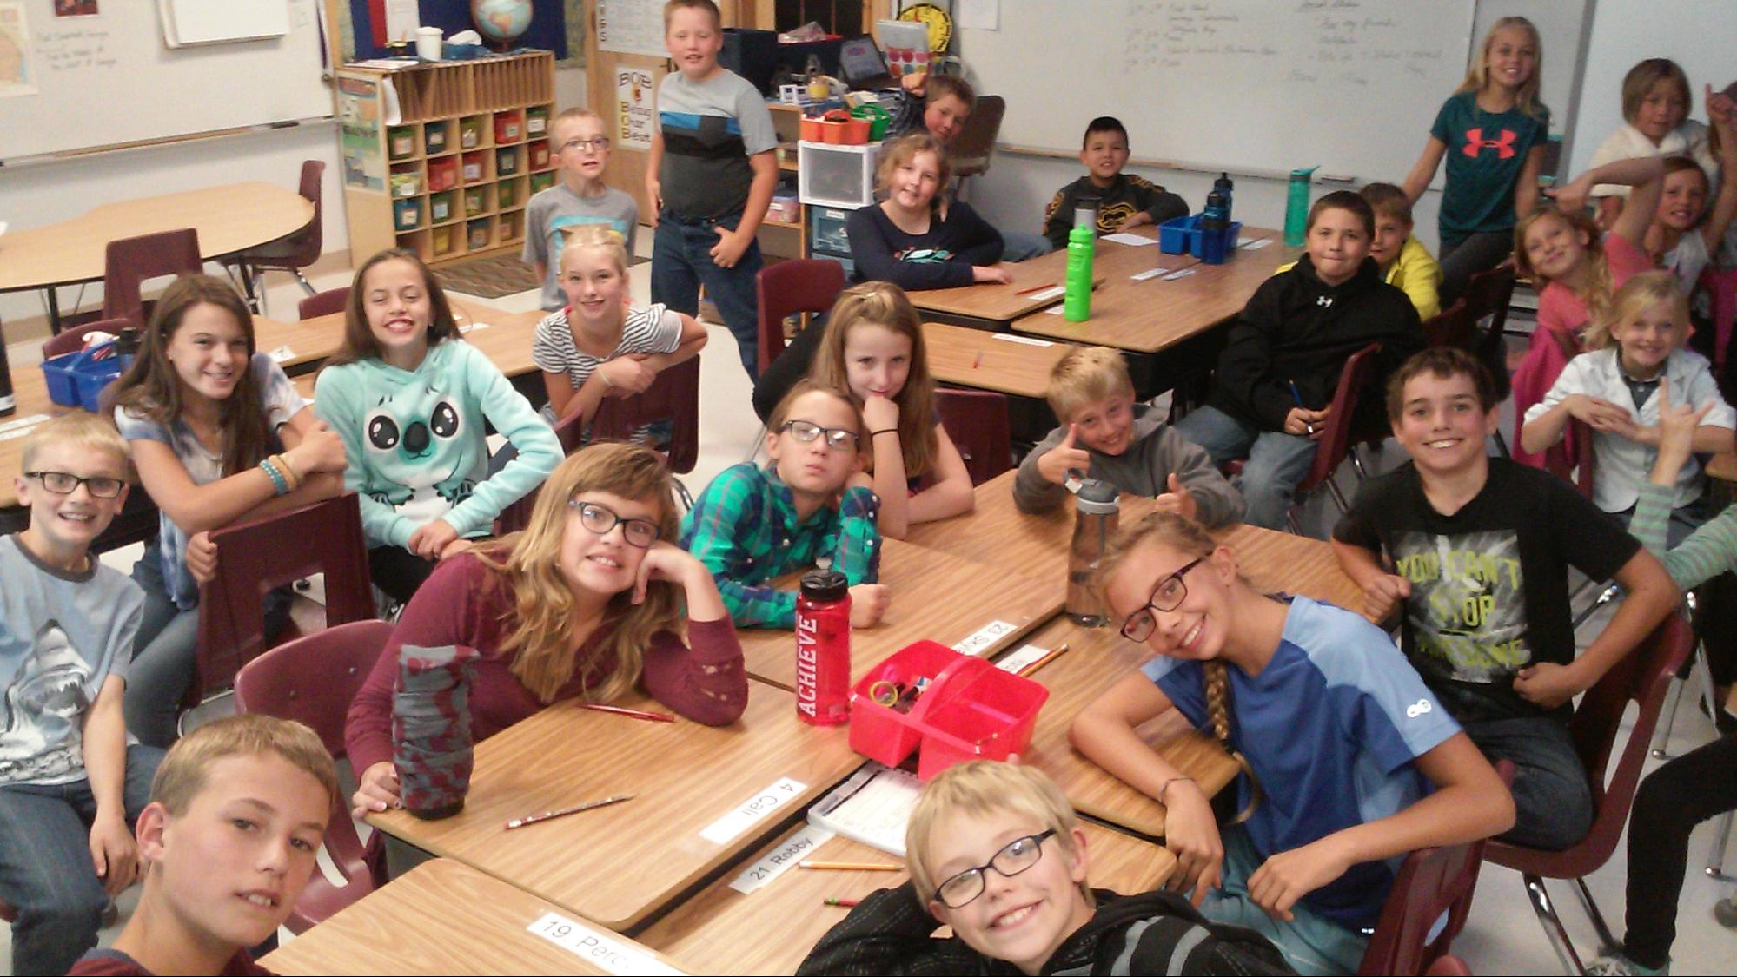
Mrs. Jorden 5th Grade

Slide 2
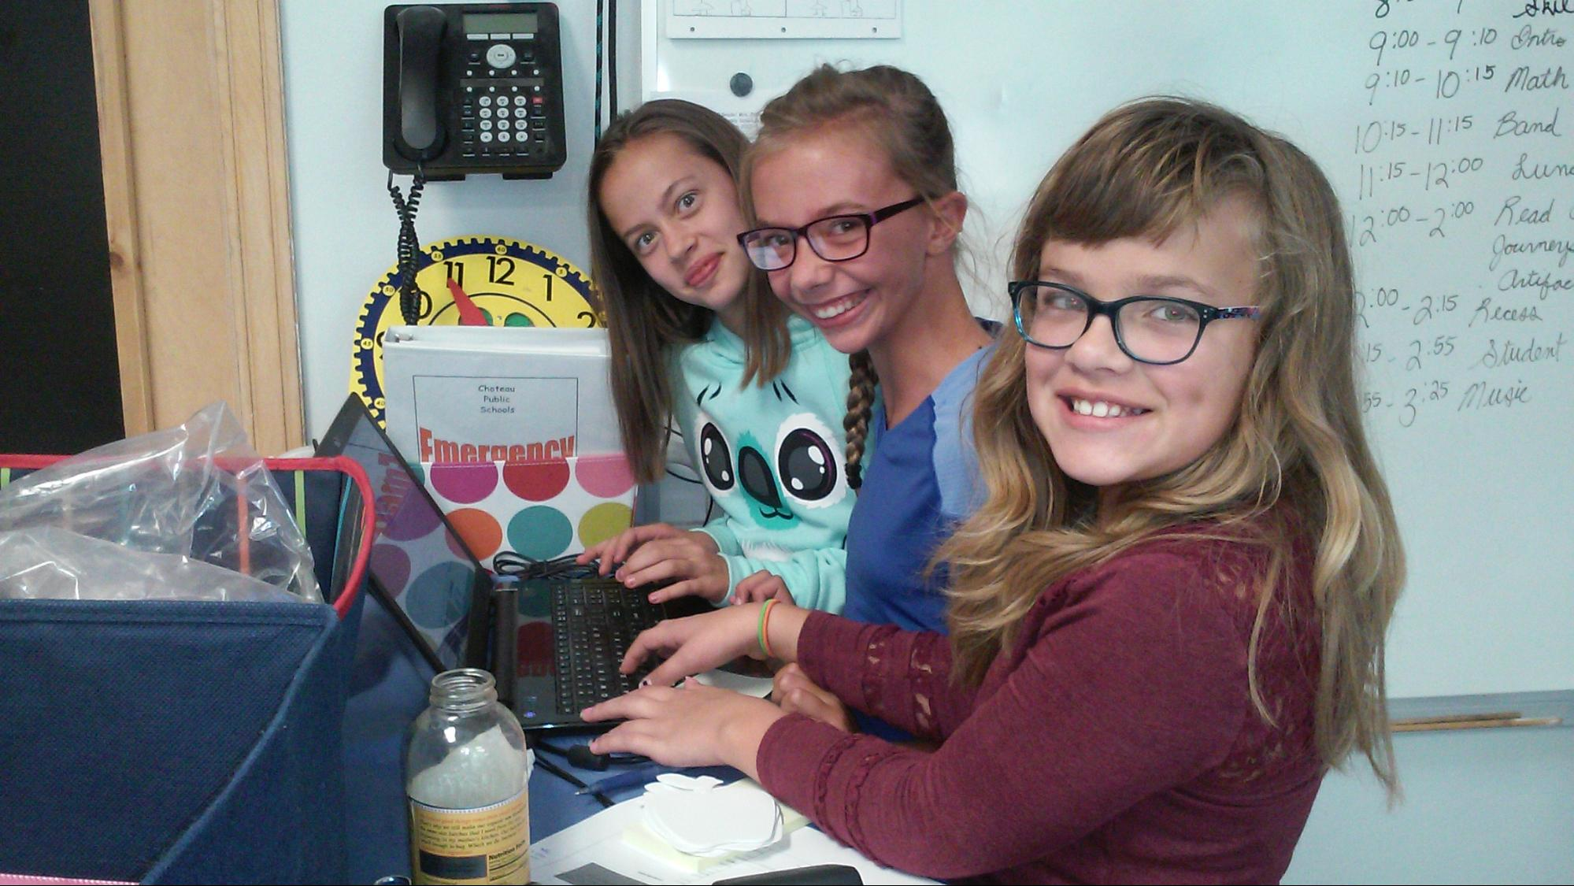
Contact information
Notes
Check Planner
Email
elizabeth.jorden@
choteauschools.net
Phone / Text
Call elem office
Check Website
http://choteauschools.net
Link to 5th Grade- MONTHLY NEWSLETTER
Announcements
REMIND - sign up

Slide 3
Introduction for Families

Slide 4
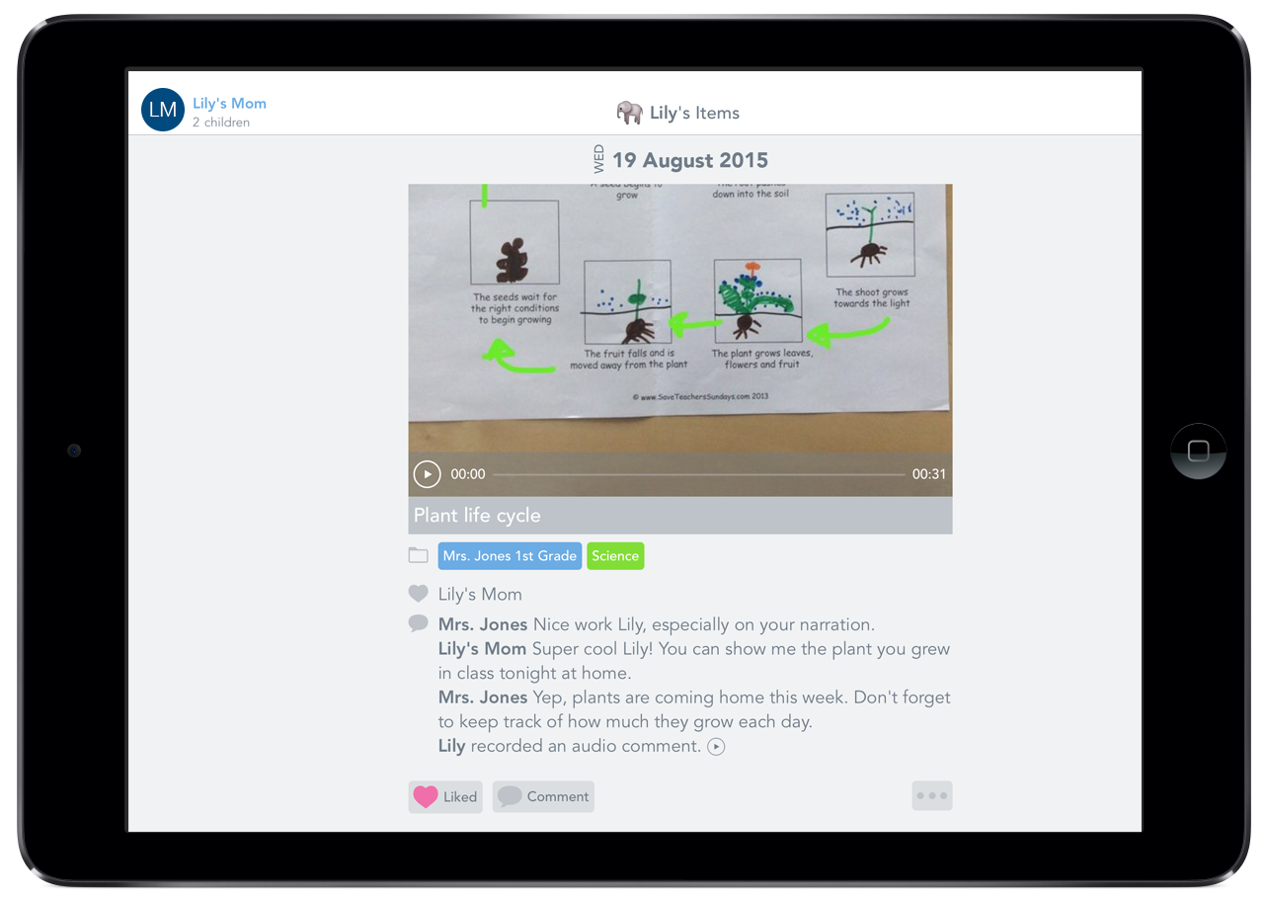
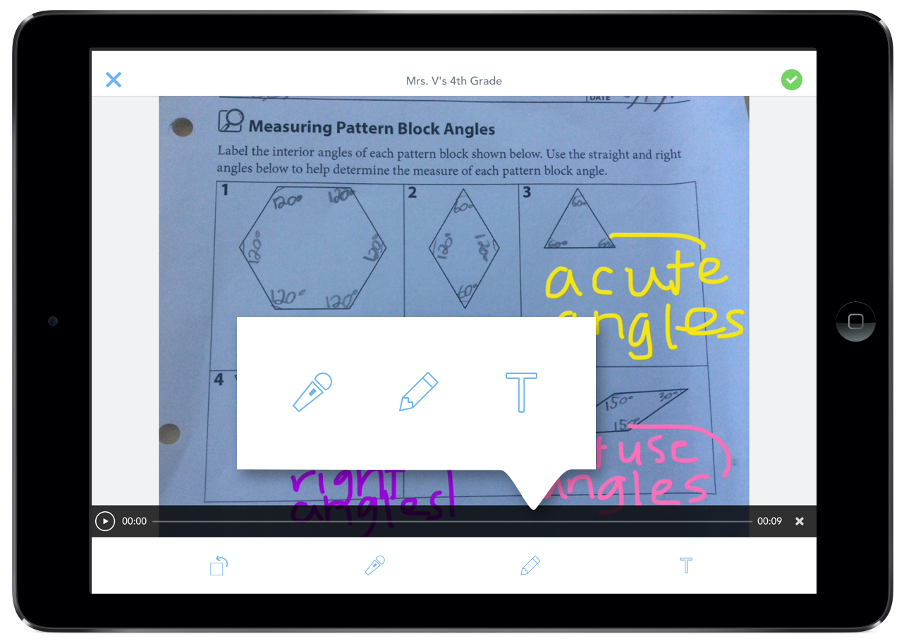
Seesaw is a new way we’re sharing what your child is learning at school.
Seesaw gives your child a place to document their learning, be creative and learn how to use technology.

Slide 5
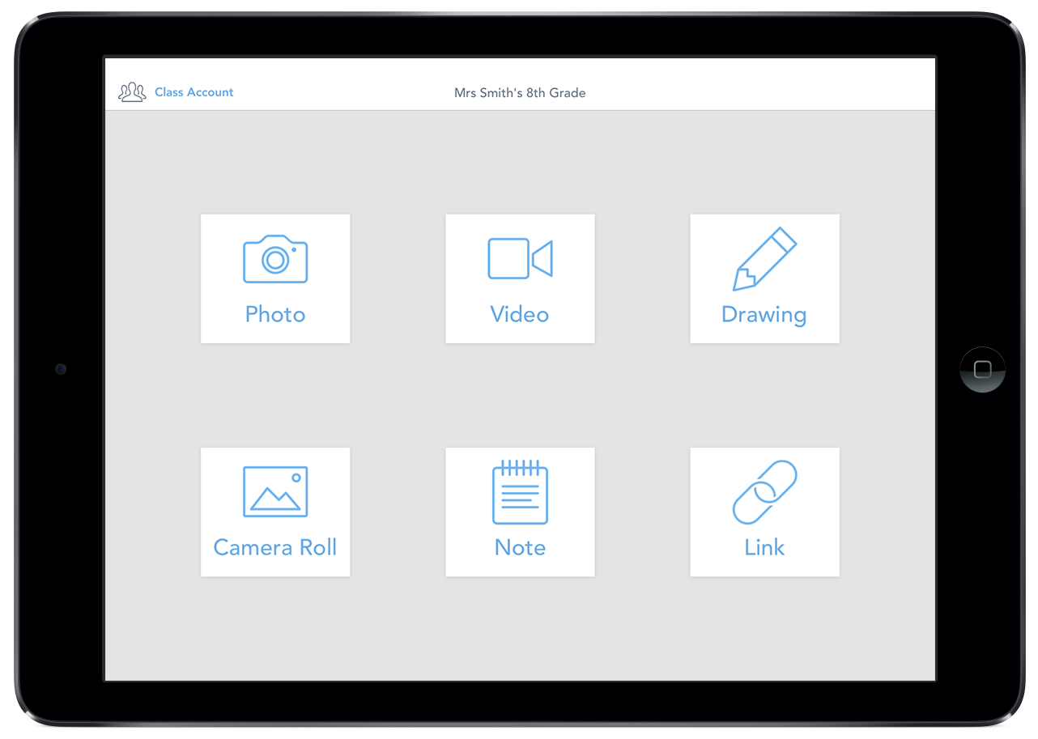
Each child gets their own journal and we will periodically add entries to it, like photos, videos, drawings, or notes.

Slide 6
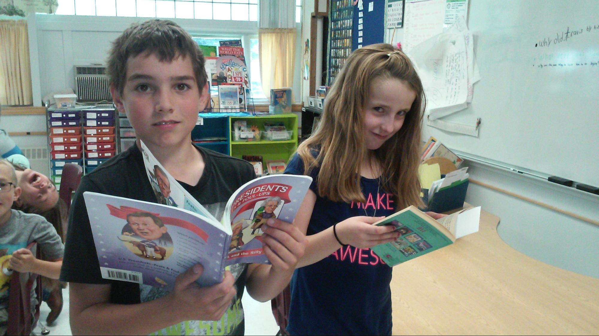
Homework
30 AR points each trimester
(points and goals on website)
Part of language arts grade
Unfinished class work if needed
Homework Club 7:45 in Elem School

Slide 7
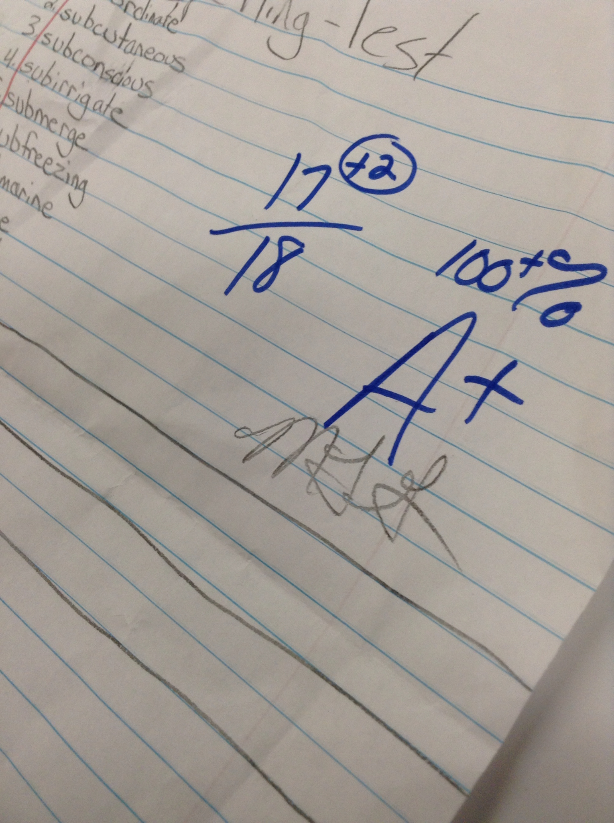
Grade Slips
Go home every other Thurs.
Sign and return by Mon.
Differentiated work
Students can retake assignments
and tests for better grade

Slide 10
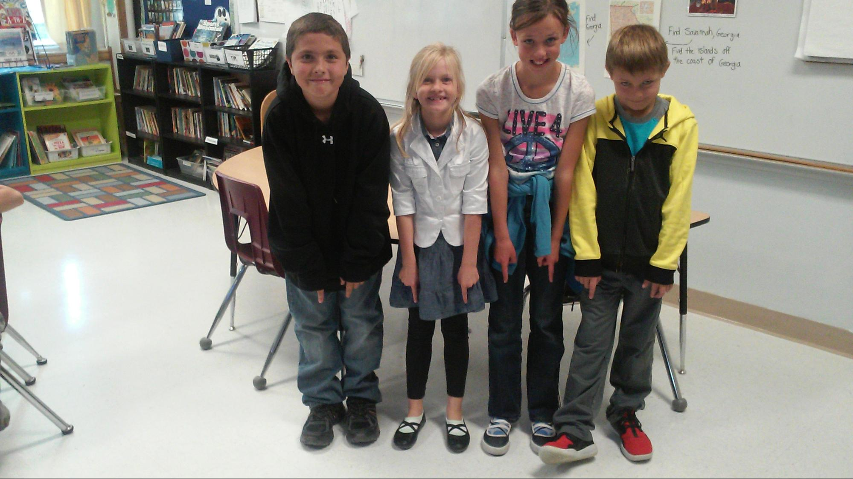
Send Extra Flip Flops, Slipper, Slides
Slip on shoes in locker
Prevent slippery floor in classroom and extra work for custodian

Slide 11
Birthdays
Just GAMES and fun
Half birthdays for
June, July and
August

Slide 12
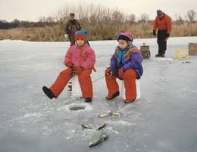
Field Trips
Heritage Festival
Great Falls
September 23 Ice Fishing Spring Trip

Slide 13
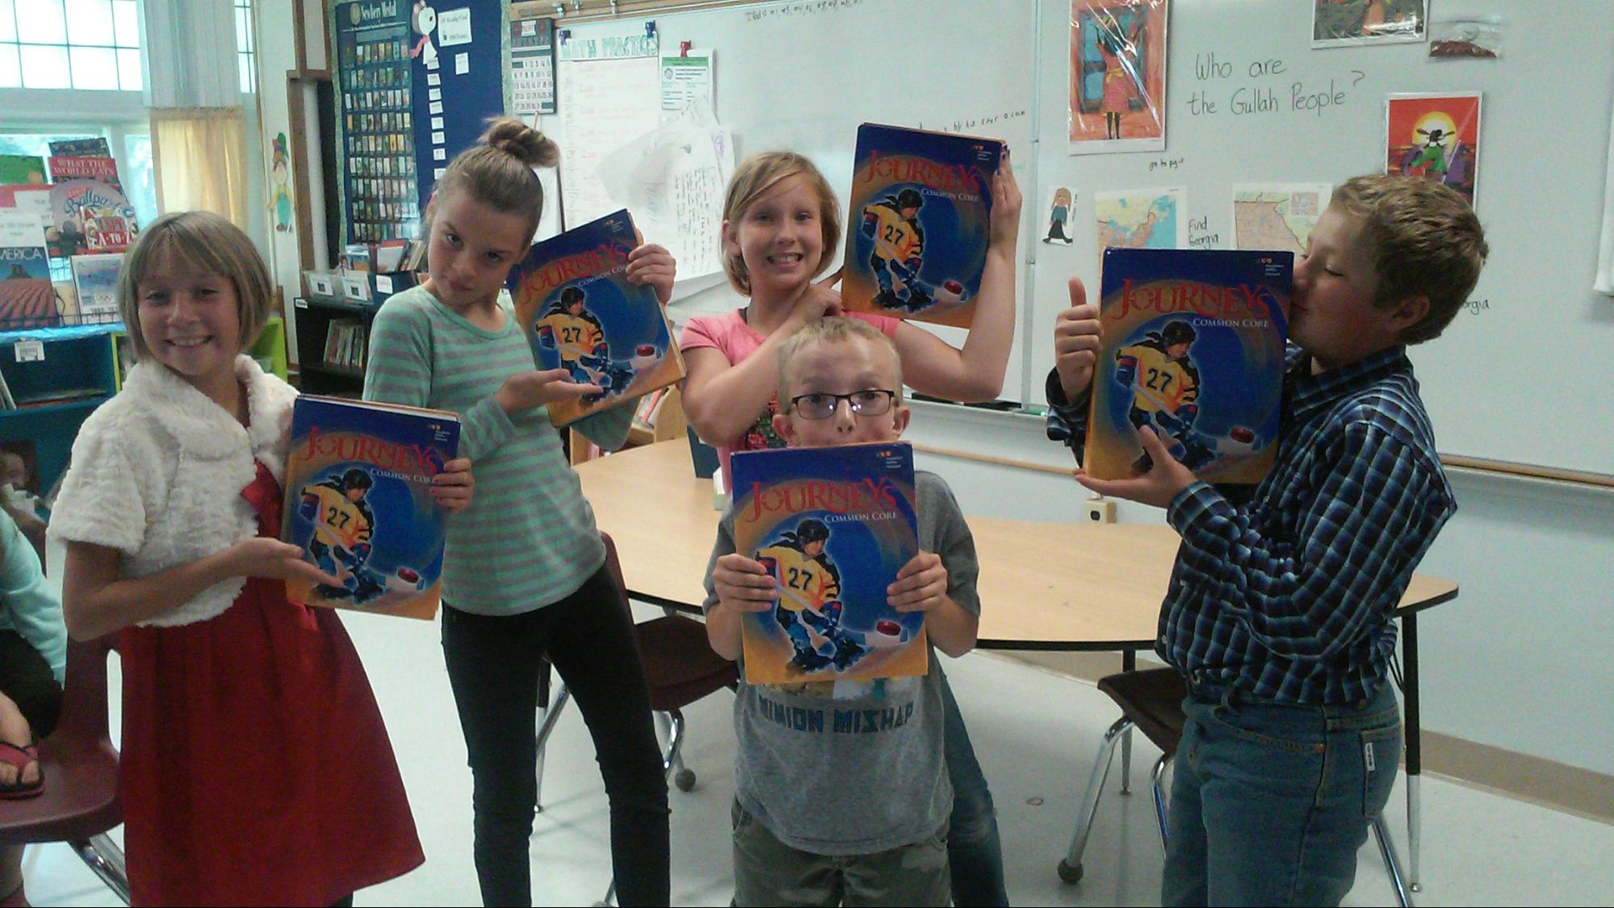
Language and reading
Journeys program / Think Central online
Access through 5th grade website

Slide 14
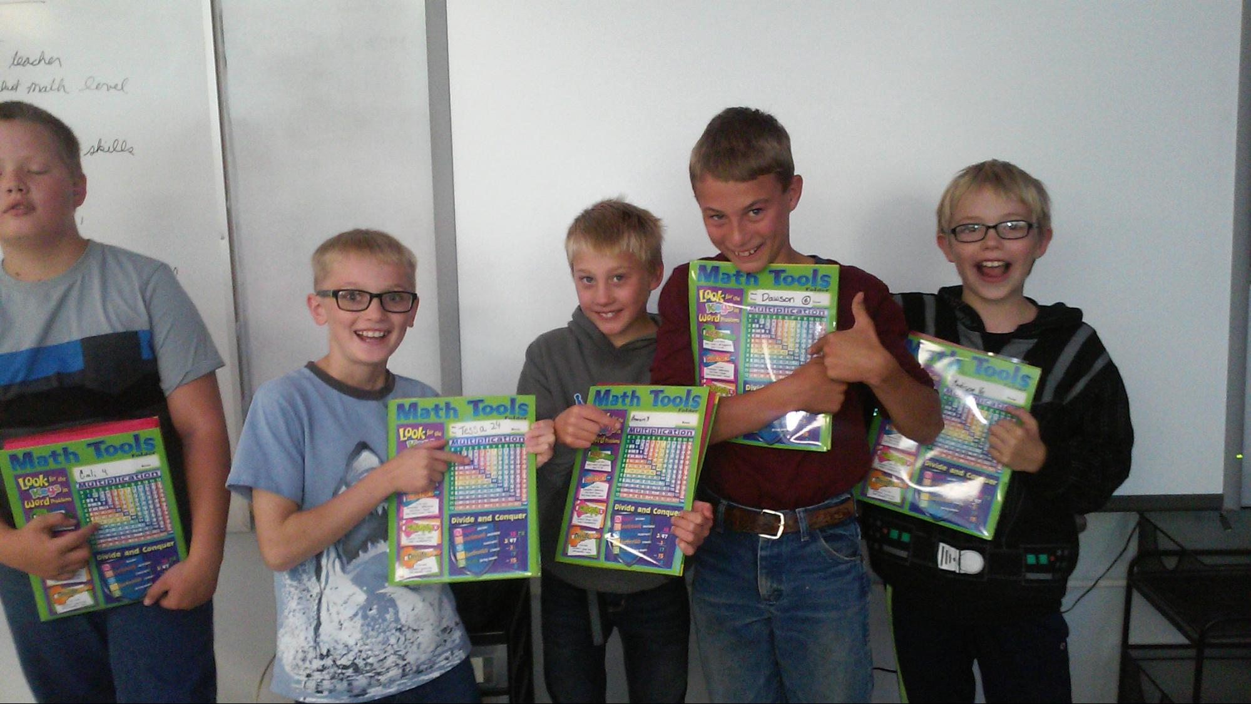
5th Grade math
Math series is also available online
ThinkCentral link
Math fact practice/ tools on website

Slide 15
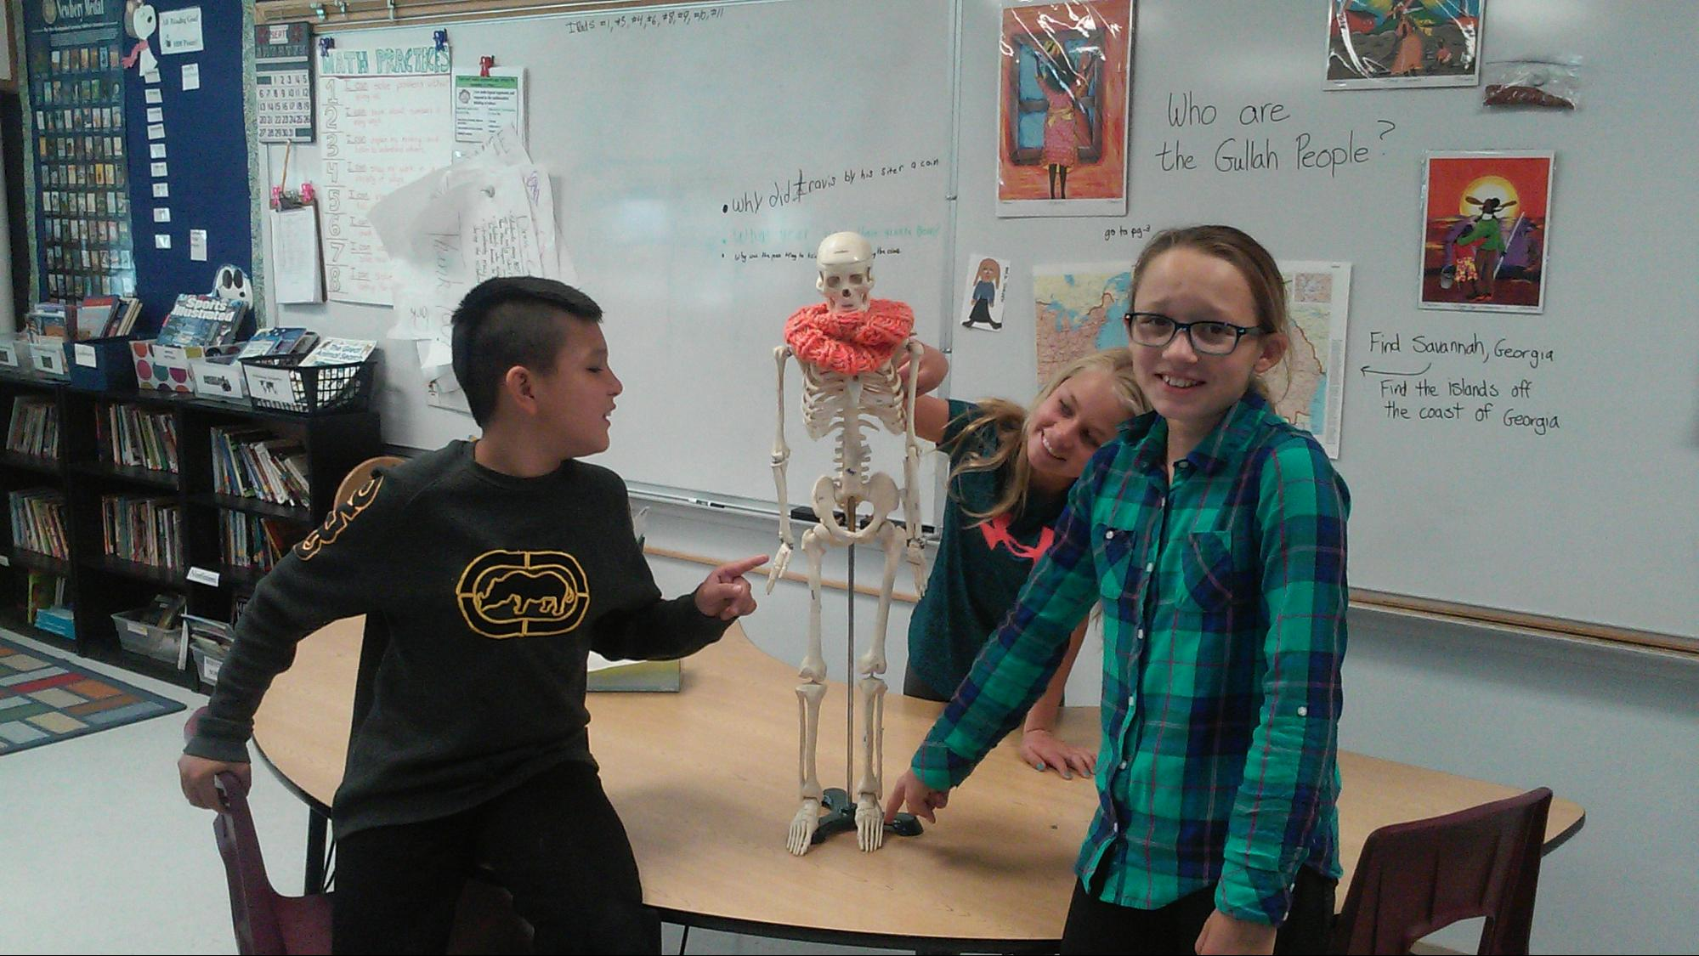
Science
Earth Materials/ FOSS online resources
Special
Science
Days

Slide 16
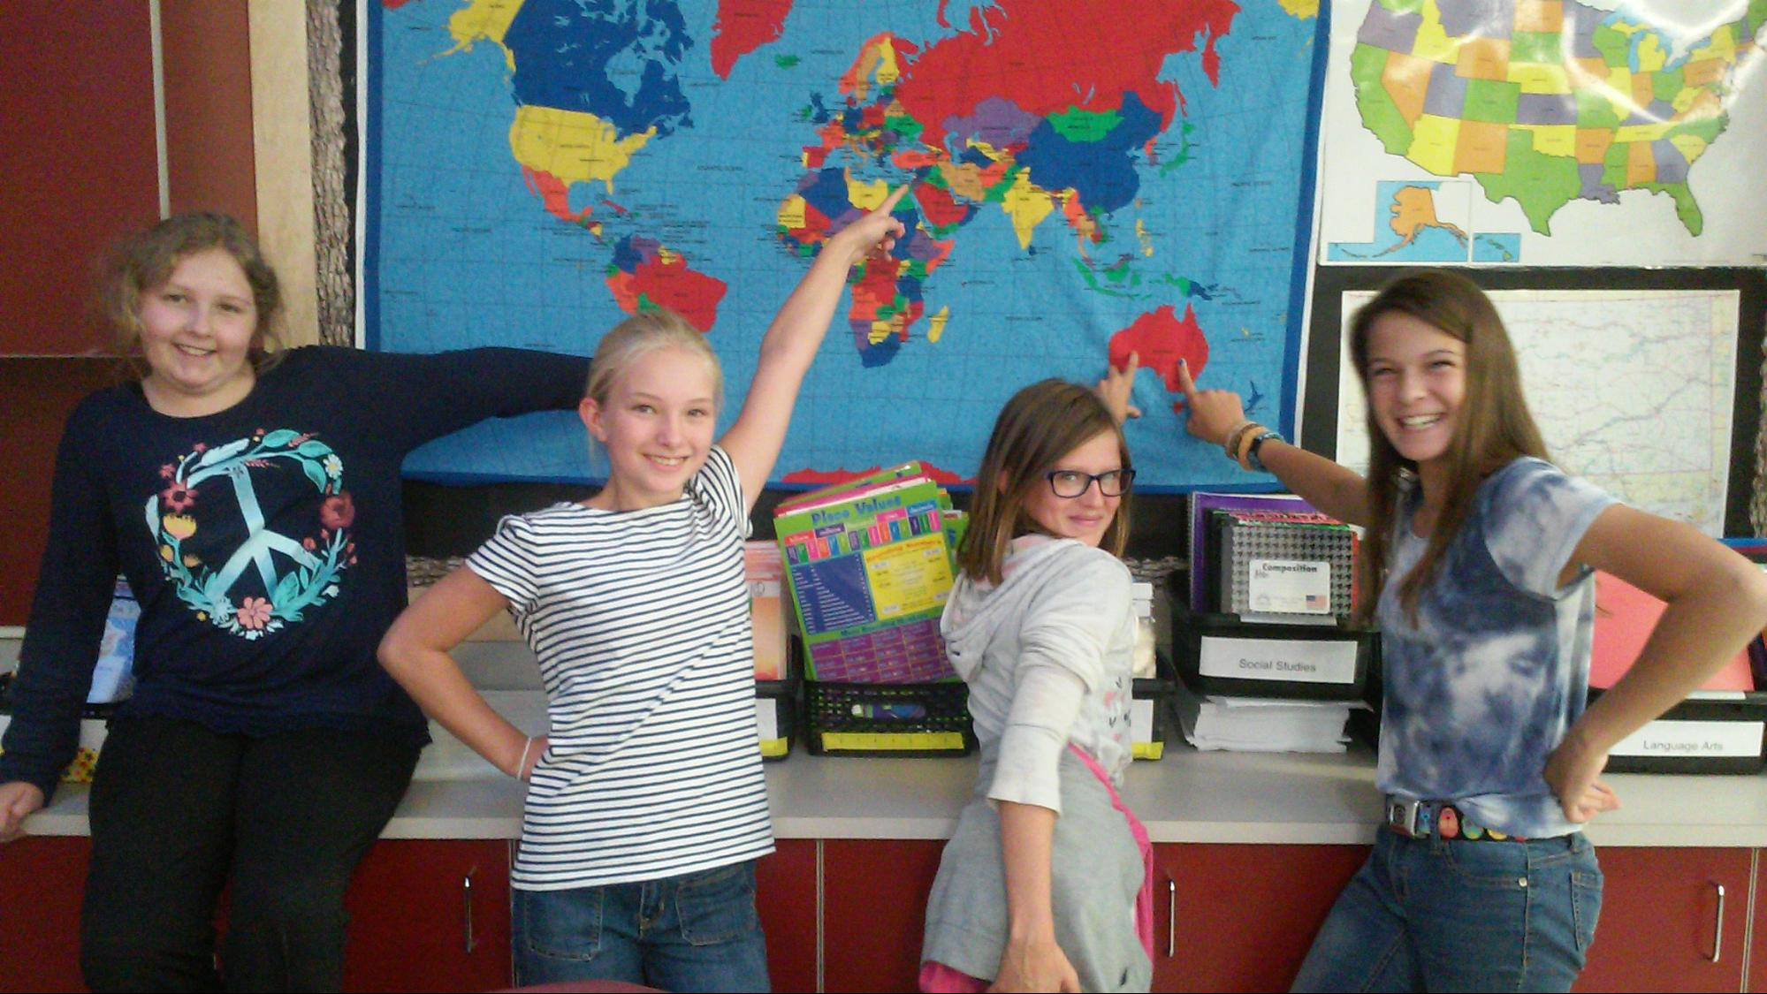
Social Studies
U.S. History
Wax Museum
Mrs. T - historical fiction challenge

Slide 17
Band
Instruments
Mrs. Depner
Home practice

Slide 18
Opportunities for all
Scholarship program
Applications in office
Lessons, supplies, etc.

Slide 19
7 Ways You can Help your child succeed
You provide the most influence on your child’s academic success

Slide 20
#1 Regular Attendance
Attendance policy
Come to school
Please be on time
If tardy, student reports to the office

Slide 21
#2 A good night’s sleep
If possible, move electronics out of bedroom
Collect Ipod/ phone
Keep regular sleep schedule

Slide 22
# 3 Look through Thursday Folder
Grade slips
discuss w/ child
sign and return
Review completed work
Check the website

Slide 23
#4 Praise Effort
You spent a lot of time reading and it shows in your language grade.
You practiced your instrument an hour extra. I’m so proud!
I like the way you kept working on the challenge problem.
You are a great reader.
Music comes so easy to you!
Math is so easy for you. You were born with the math gene!

Slide 24
#5 Talk about Bullying
Repeated harassment ( physical or verbal)
Bullying Policy – Bully, Bullied, Bystander
Stage 1 Inform, document and monitor in classroom
Stage 2 Principal investigates, parents informed
Stage 3 All parents involved will meet with staff to develop strategy
Stage 4 External parties’ support may be sought

Slide 25
#6 Get Involved in the Classroom
Classroom Library Organizing / Classroom Prep jobs at home
Listen to readers
Math fact practice
Science helpers
Wax Museum helpers

Slide 26
#7 READ and Encourage Reading

Slide 27
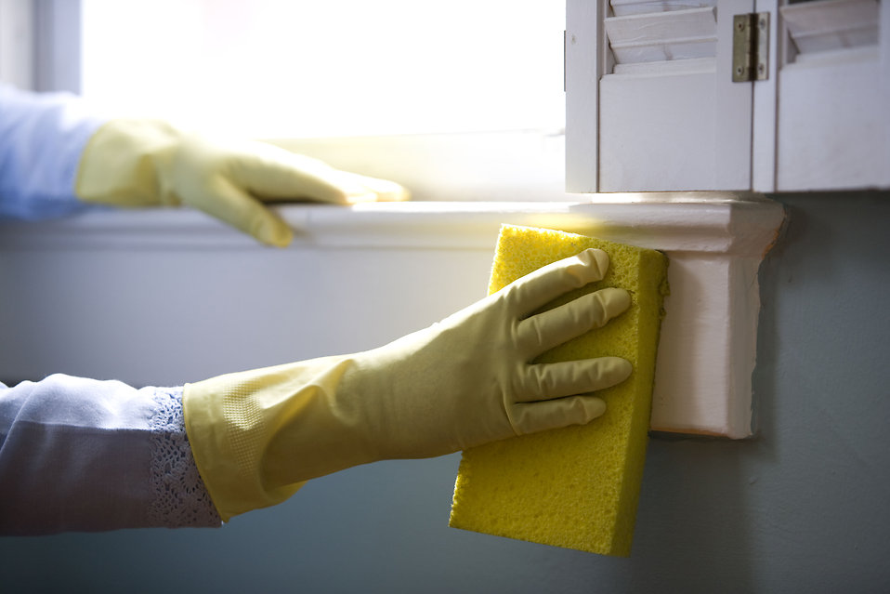
Classroom Cleaning
After school
1st of every month
½ hour max!

Slide 28
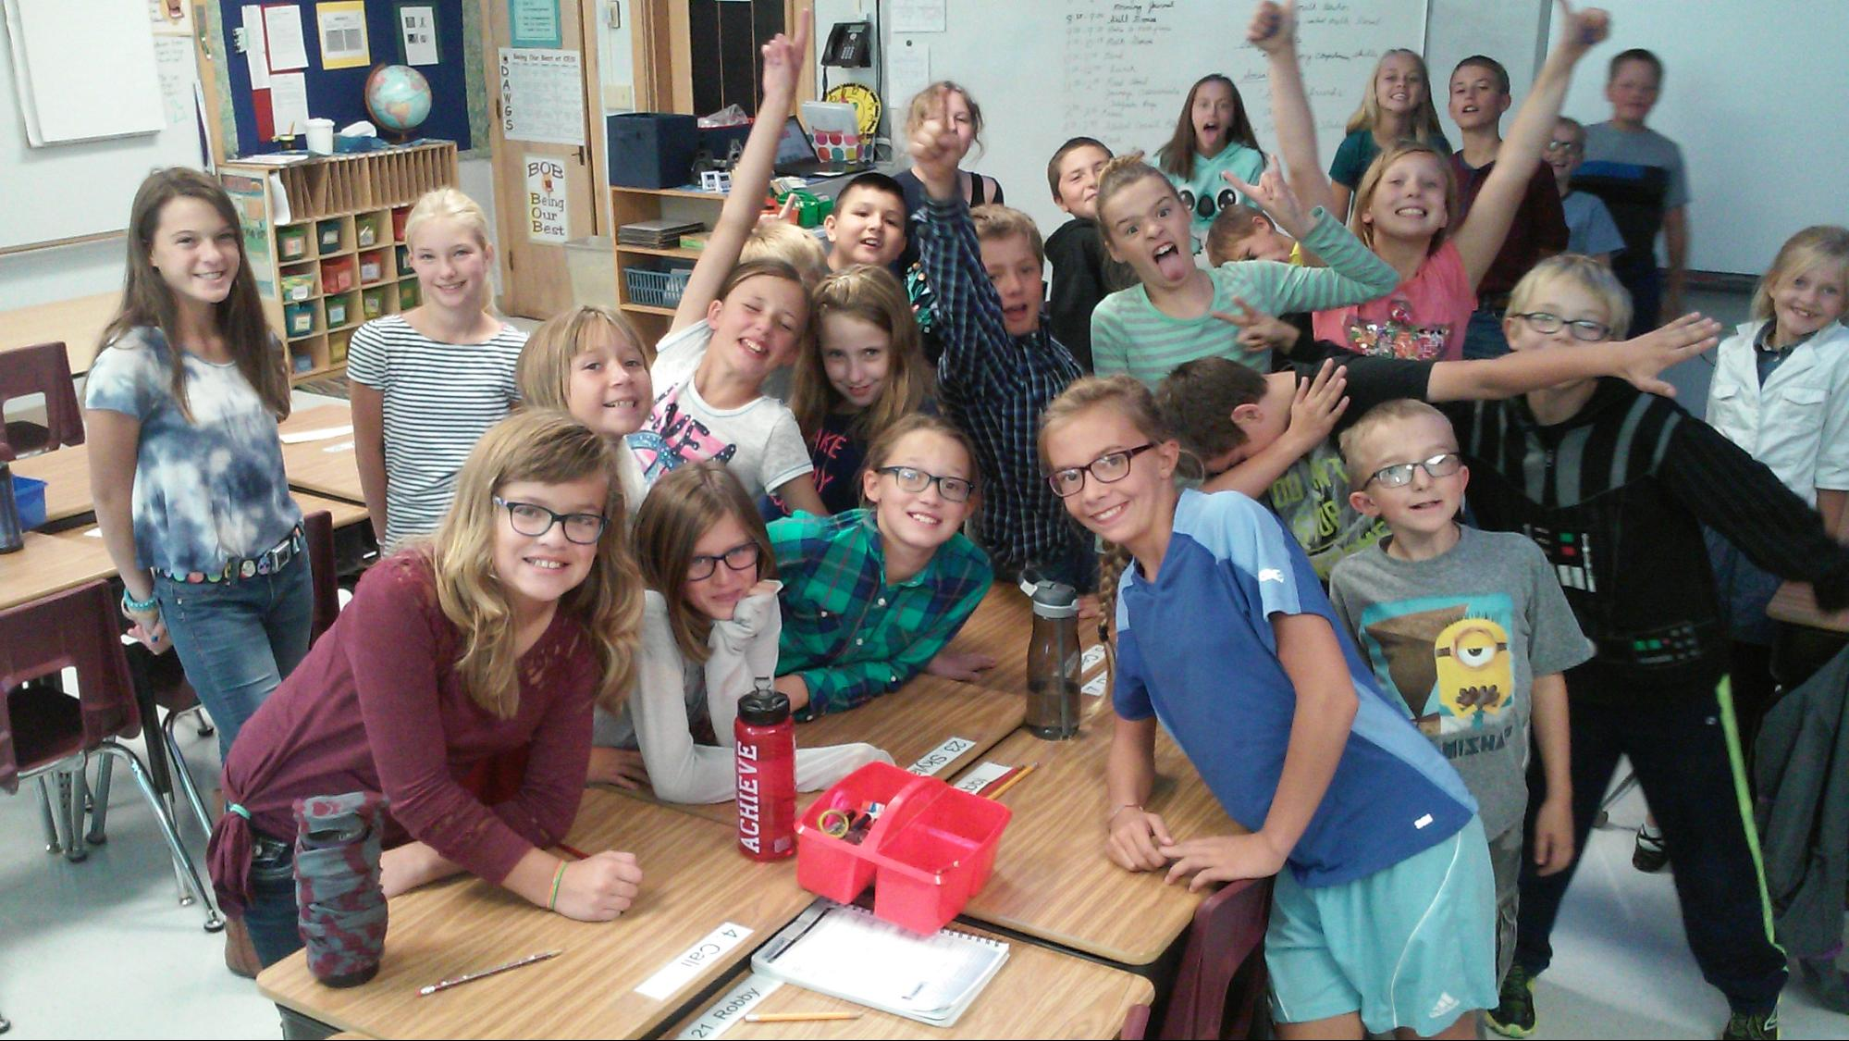
thanks for supporting your child’s education!

