Slide 1
5th Grade Math Vocabulary
Unit 1
Add and Subtract with Fractions

Slide 2
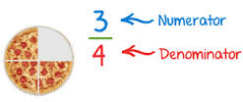
Denominator
Number of unit fractions made by dividing the whole number into equal parts

Slide 3
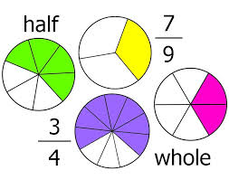
fraction
A number that is a sum of unit fractions, each an equal part of a set or a whole

Slide 4
numerator
Tells the number of unit fractions the fraction represents

Slide 5
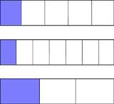
unit fraction
A fraction with a numerator of 1. One equal part of a whole.

Slide 6
equivalent fractions
Fractions that represent the same value

Slide 7
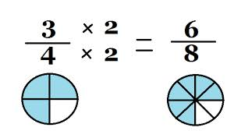
multiplier
The number the numerator and denominator of a fraction are multiplied by to get an equivalnet fraction

Slide 8
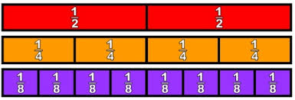
n-split
To divide each unit fraction into n equal parts

Slide 9
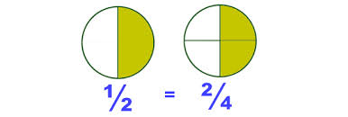
simplify
Make an equivalent fraction by dividing the numerator and the denominator by the same number.
Makes fewer, but larger parts.
‘reducing’

Slide 10
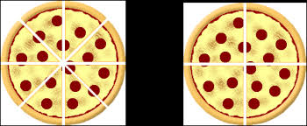
unsimplify
Make an equivalent fraction by multiplying the numerator and the denominator by the same number.
Makes more, but smaller parts.

Slide 11
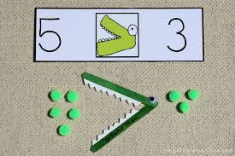
greater than >
a symbol used to show how 2 numbers compare.
The greater number goes before the symbol

Slide 12
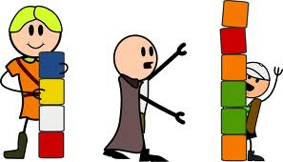
less than <
a symbol used to show how 2 numbers compare.
The lesser number goes before the symbol

Slide 13
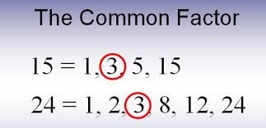
common factor
a factor that 2 or more numbers share

Slide 14
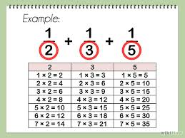
common denominator
a common multiple of two or more denominators

Slide 15
benchmark
a point of reference used for comparing and estimating
example (0, 1/2, 1 )

Slide 16
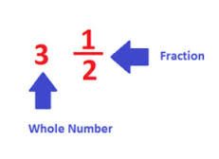
mixed number
a number with a whole number part and a fraction part

Slide 17
add on
7 1/5 - 2 4/5
find the difference between 2 numbers
by adding the lesser number to the greater number

Slide 18
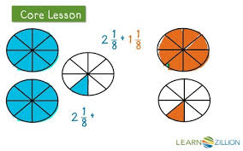
regroup
to write a number in a different form by changing the way it is grouped

Slide 19
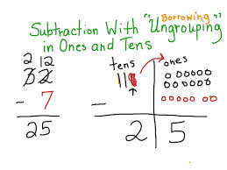
ungroup
To break into smaller groups in order to subtract

Slide 20
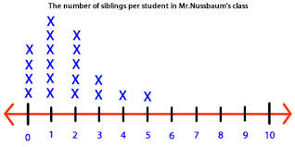
line plot
a diagram that uses a number line to show the frequency of data

Slide 21
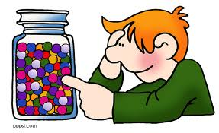
estimate
Find about how many or how much, often using rounding or benchmark number

Slide 22
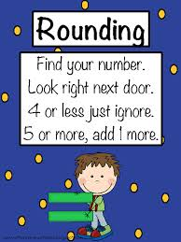
round
to change a number to a nearby number

